Slide 1

CO2 Emissions Prediction
P305 (Group-2)
Group Members:
- Ms ISHIKA PRASHANT WELEKAR
- MUPPALLA AJITH KUMAR
- Mr. N Deepak Ram
- Mr. Samit Dhawal
- Sujeeth kothwal
- Mr. Sandesh Halli
- Mrs. Kanuri Geeta Manasa

Slide 2
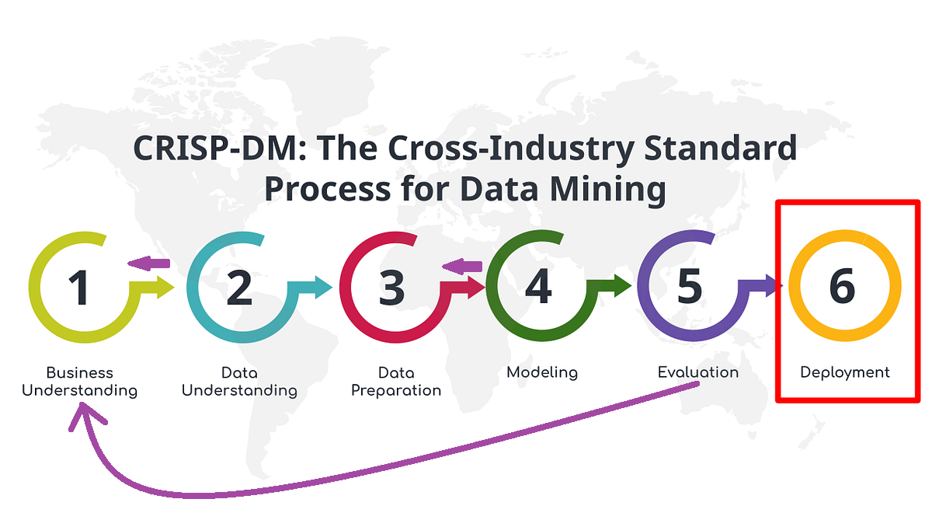
Project Flow

Slide 3
Business Understanding
Business objective
The objective is to develop a Machine Learning model to predict CO2 emissions based on various vehicle attributes.
Data Set Details:
The file contains the data for this example. Here the number of variables (columns) is 12, and the number of instances (rows) is 7385. In that way, this problem has the 12 following variables:
make, car brand under study.
model, the specific model of the car.
vehicle_class, car body type of the car.
engine_size, size of the car engine, in Litres.
cylinders, number of cylinders.
transmission, "A" for 'Automatic', "AM" for 'Automated manual', "AS" for 'Automatic with select shift', "AV" for 'Continuously variable', "M" for 'Manual'.
fuel_type, "X" for 'Regular gasoline', "Z" for 'Premium gasoline', "D" for 'Diesel', "E" for 'Ethanol (E85)', "N" for 'Natural gas'.
fuel_consumption_city, City fuel consumption ratings, in litres per 100 kilometres.
fuel_consumption_hwy, Highway fuel consumption ratings, in litres per 100 kilometres.
fuel_consumption_comb(l/100km), the combined fuel consumption rating (55% city, 45% highway), in L/100 km.
fuel_consumption_comb(mpg), the combined fuel consumption rating (55% city, 45% highway), in miles per gallon (mpg).
co2_emissions, the tailpipe emissions of carbon dioxide for combined city and highway driving, in grams per kilometer.

Slide 4
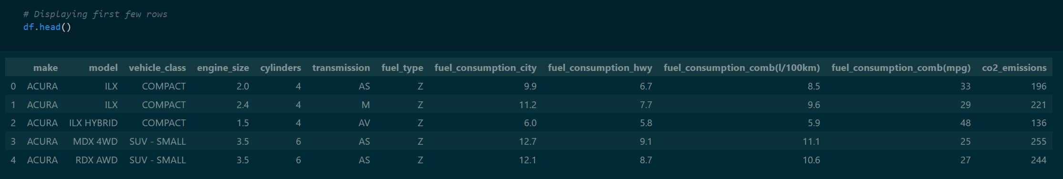
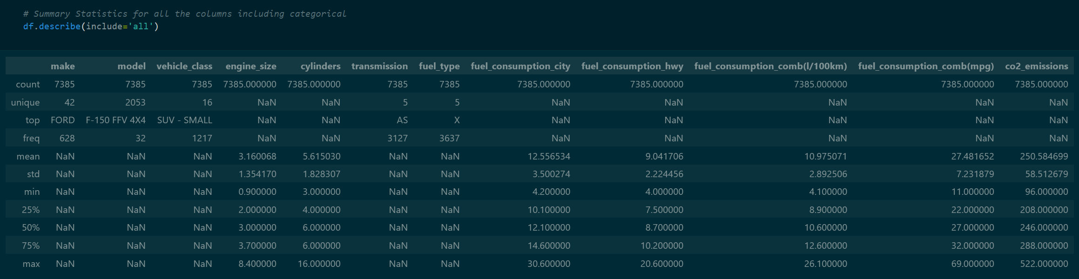
Data Understanding

Slide 5
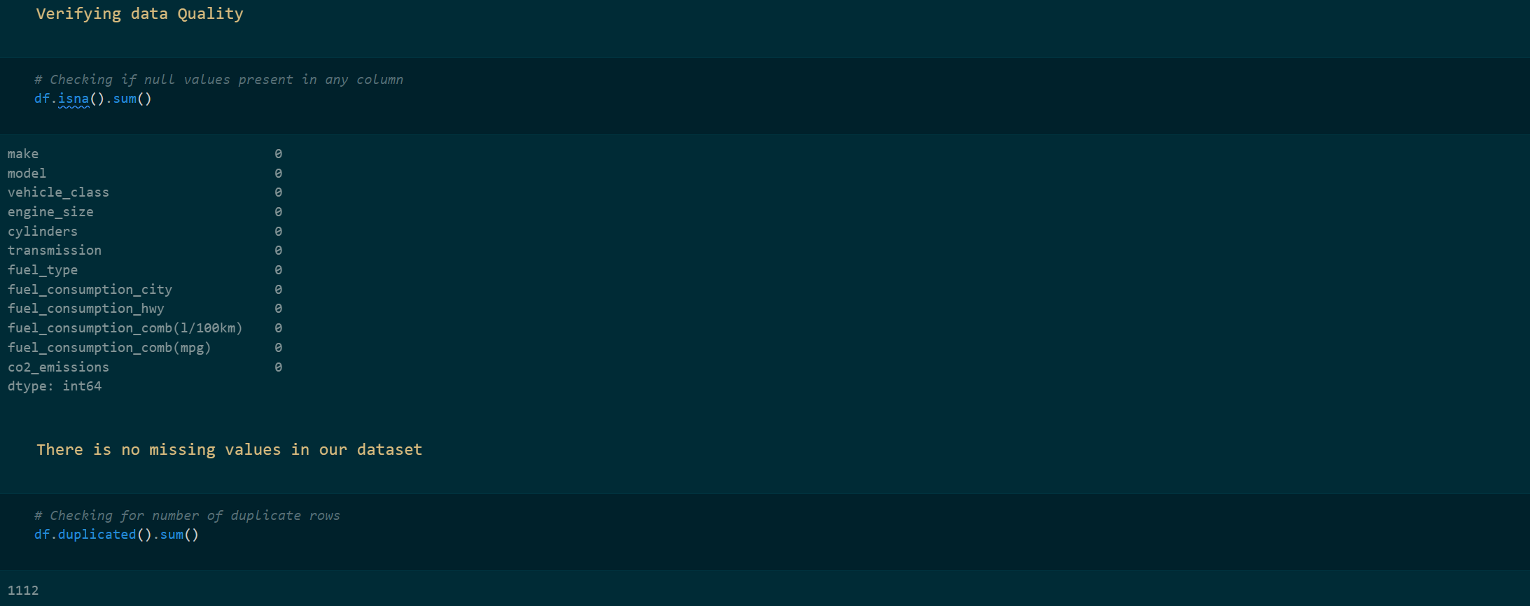
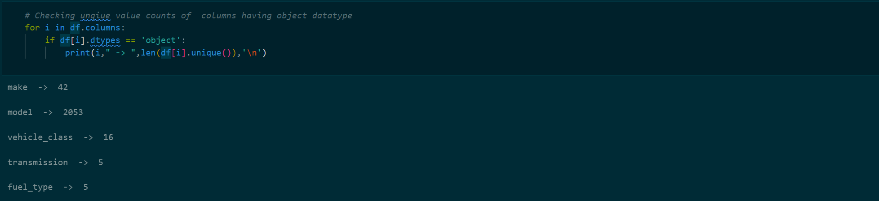

Slide 6
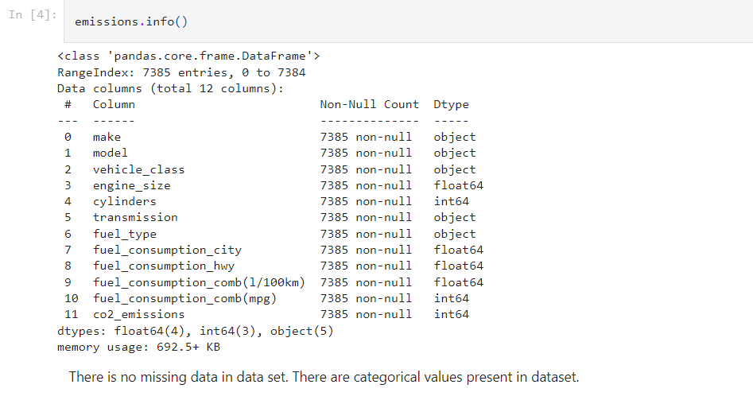

Slide 7
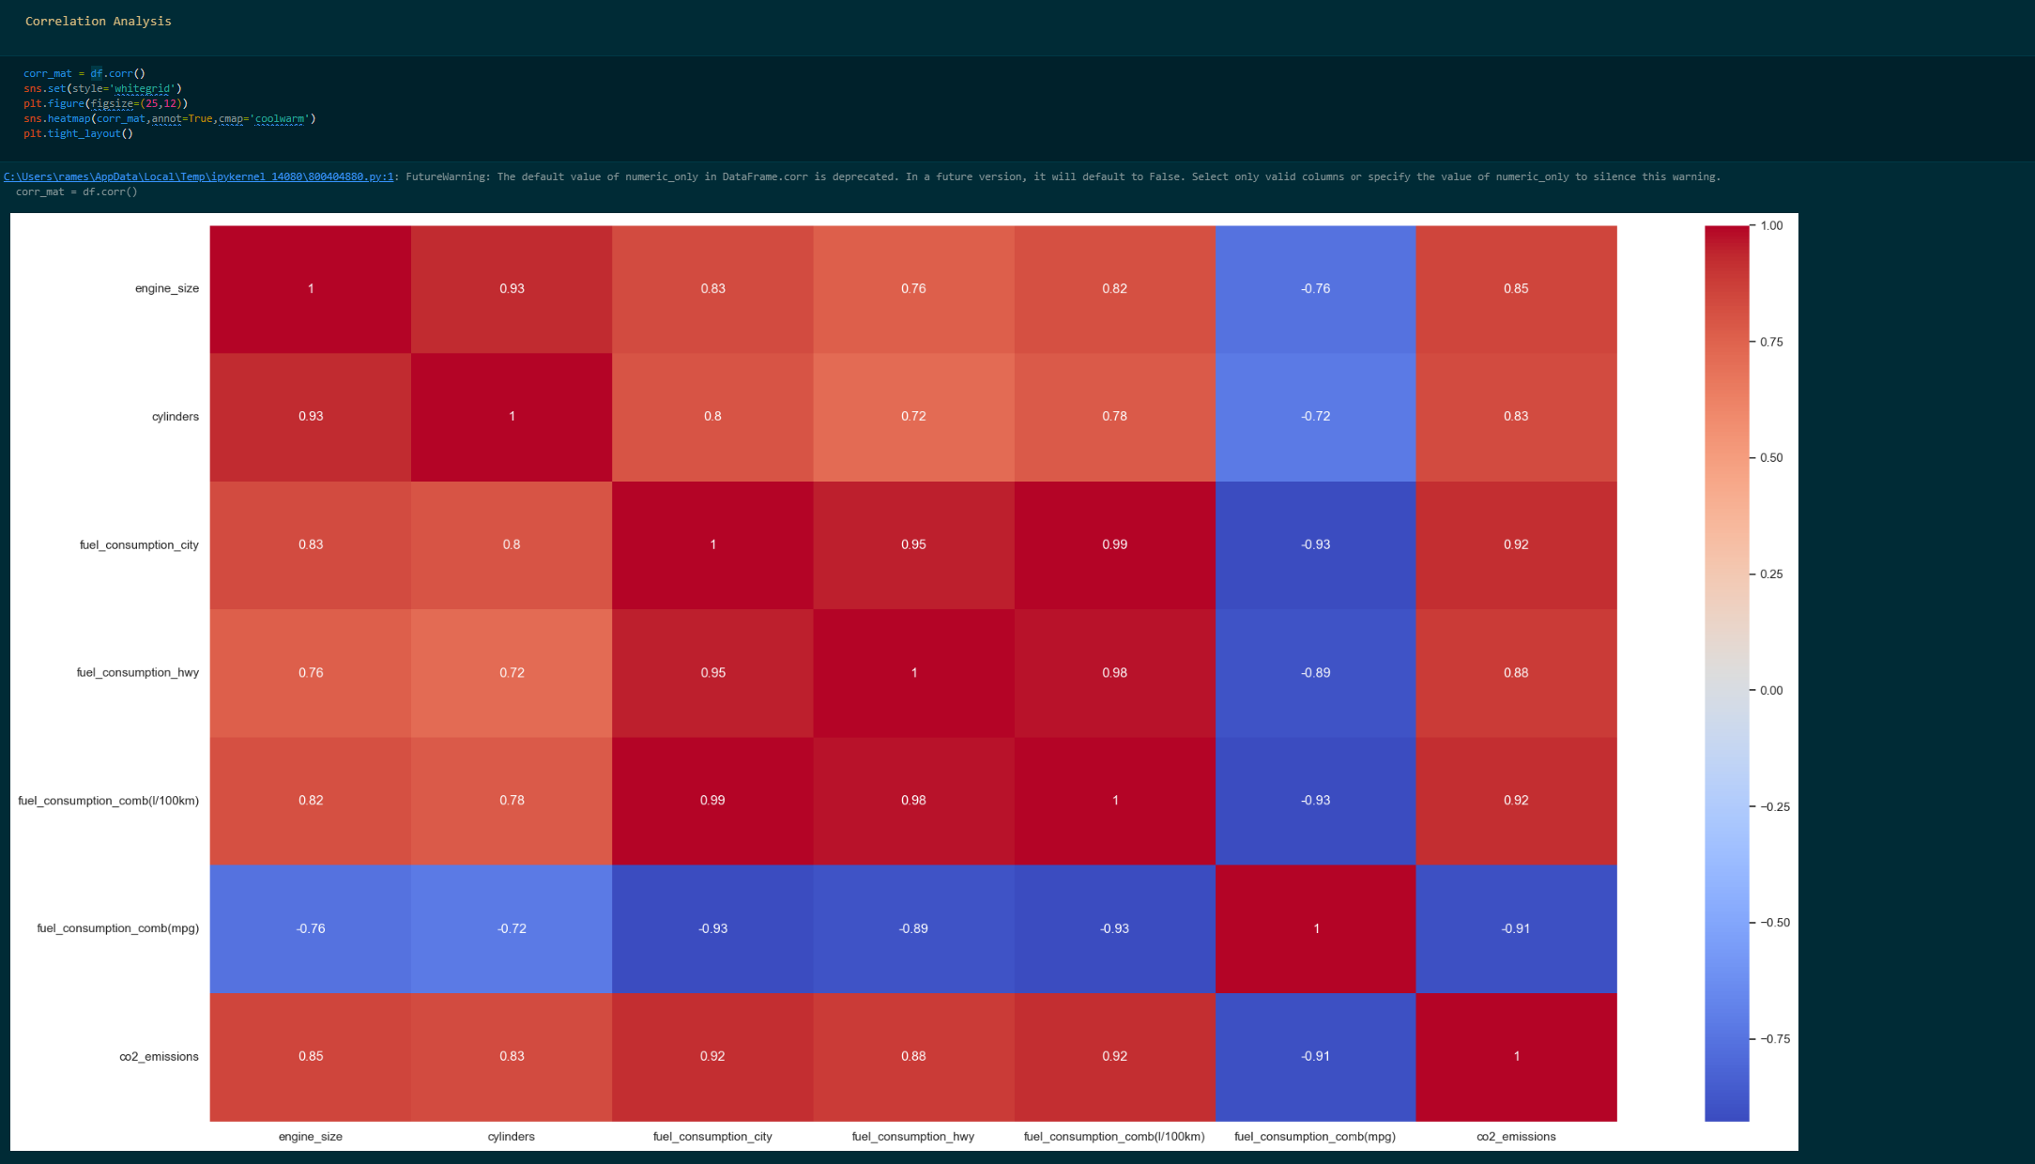

Slide 8
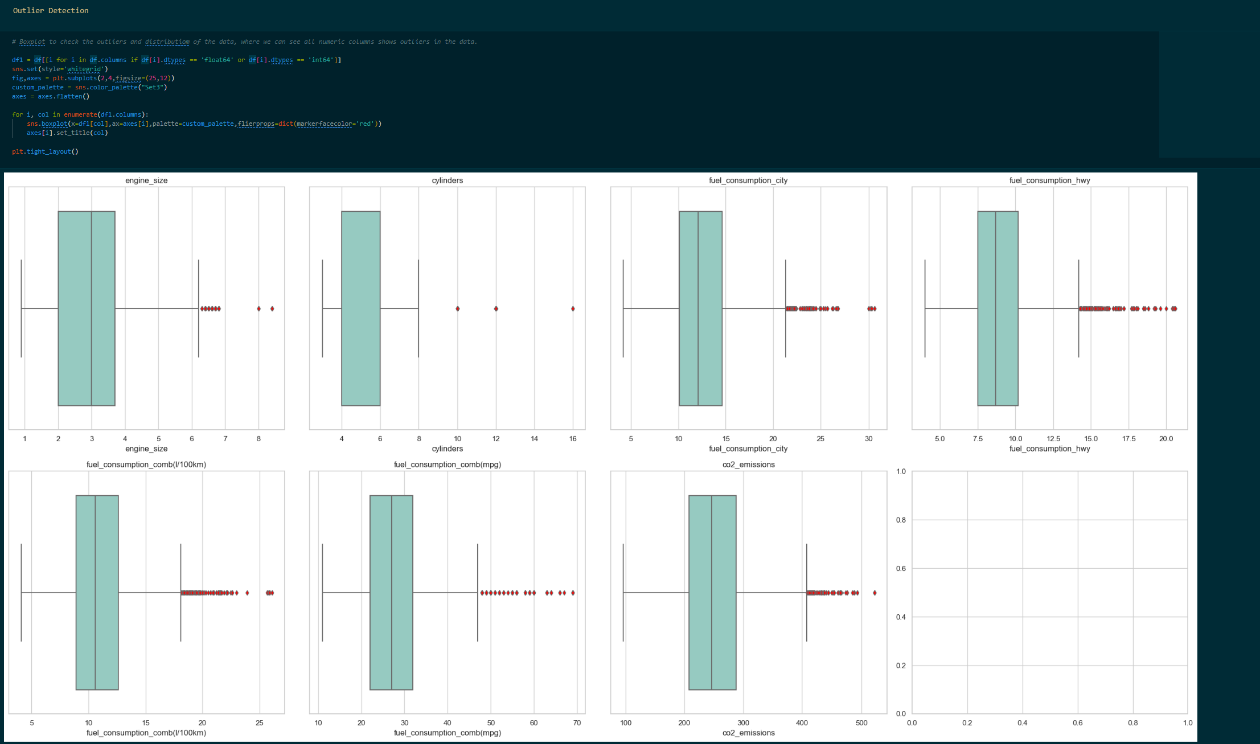

Slide 9
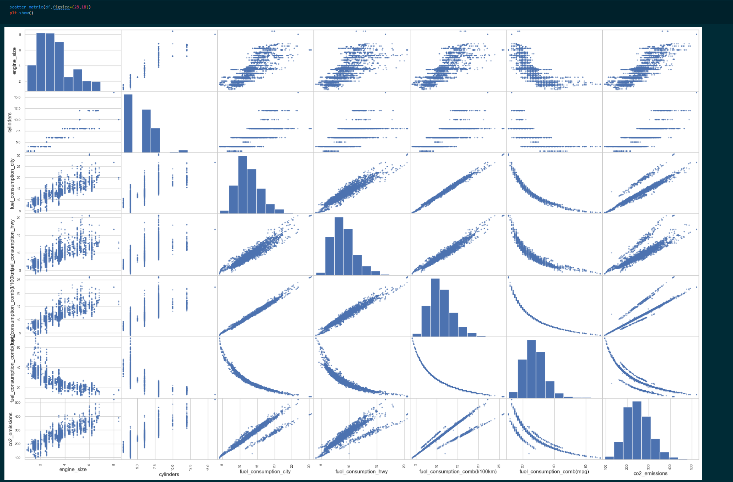

Slide 10
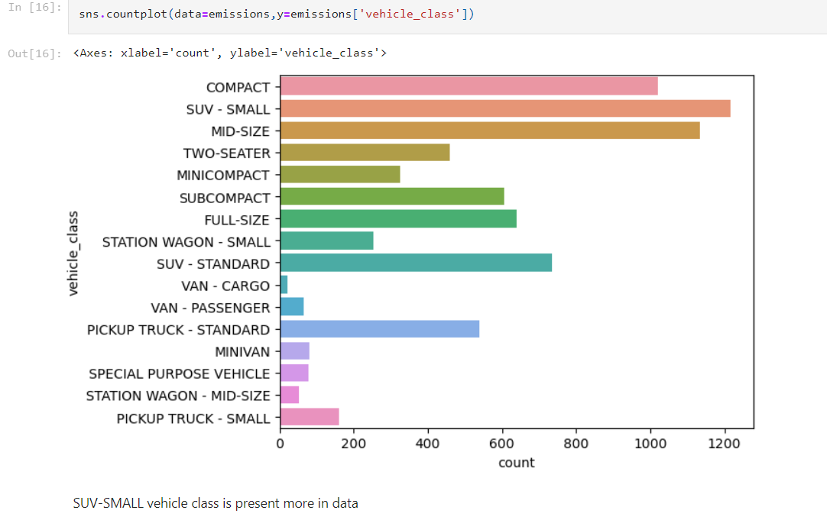

Slide 11
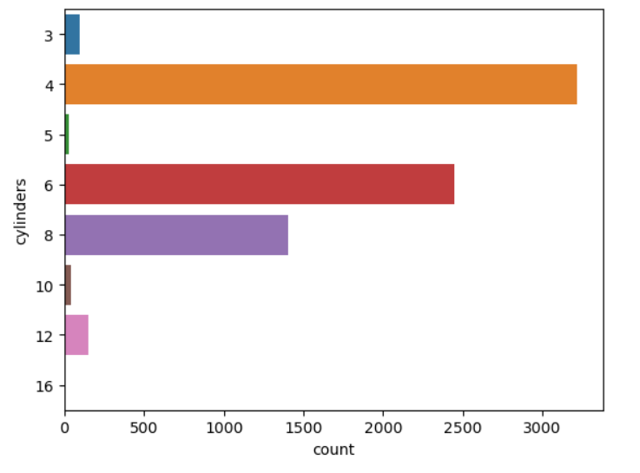
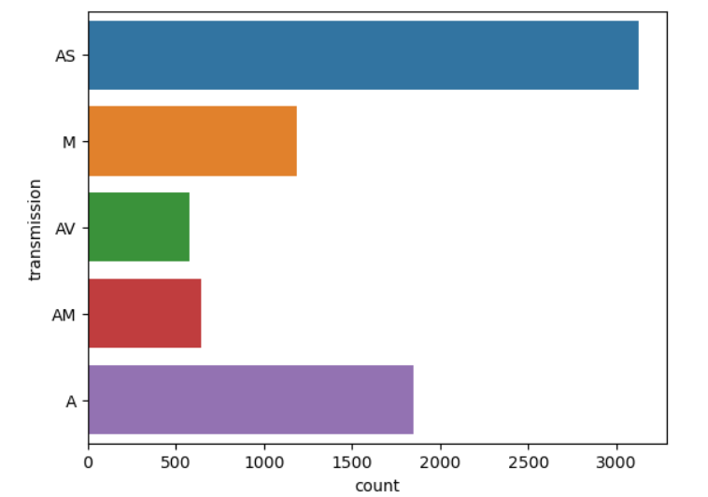
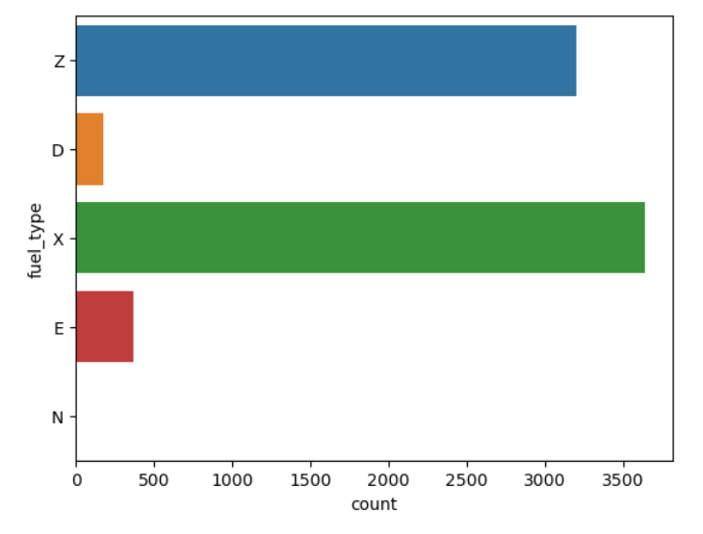

Slide 12
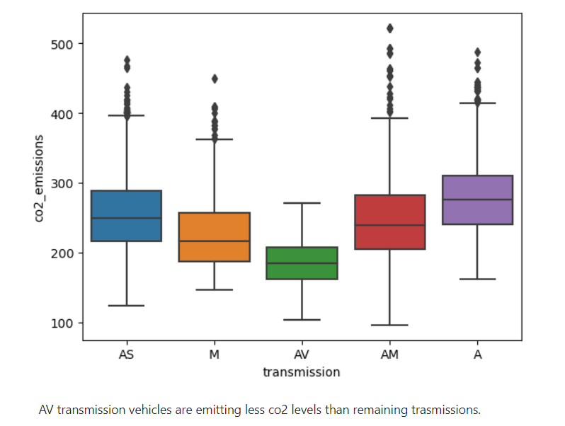
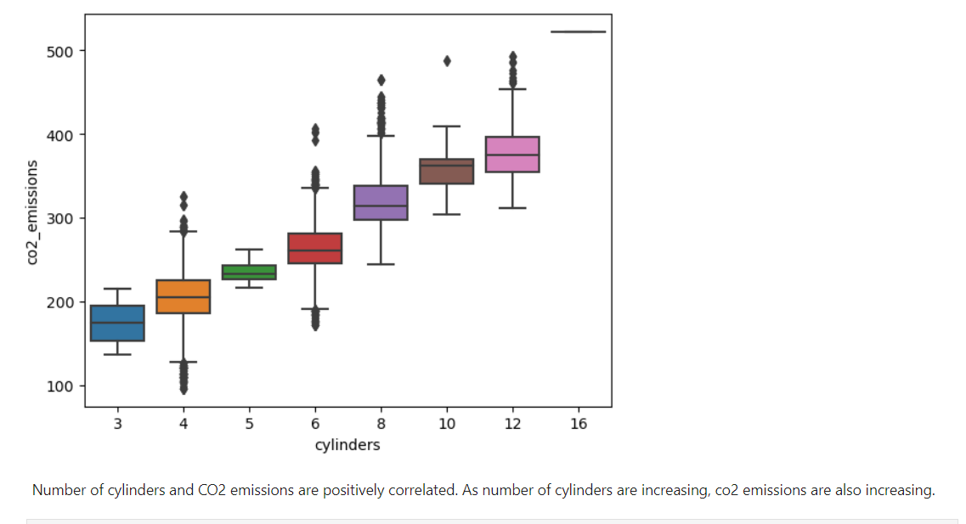
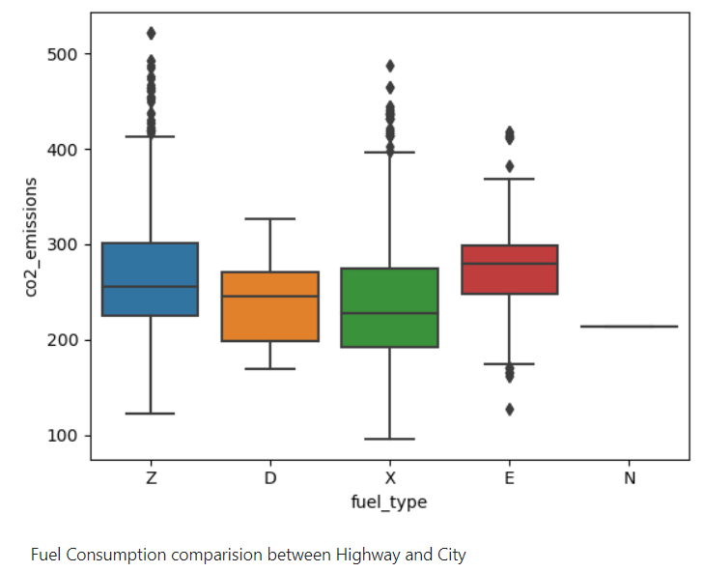

Slide 13
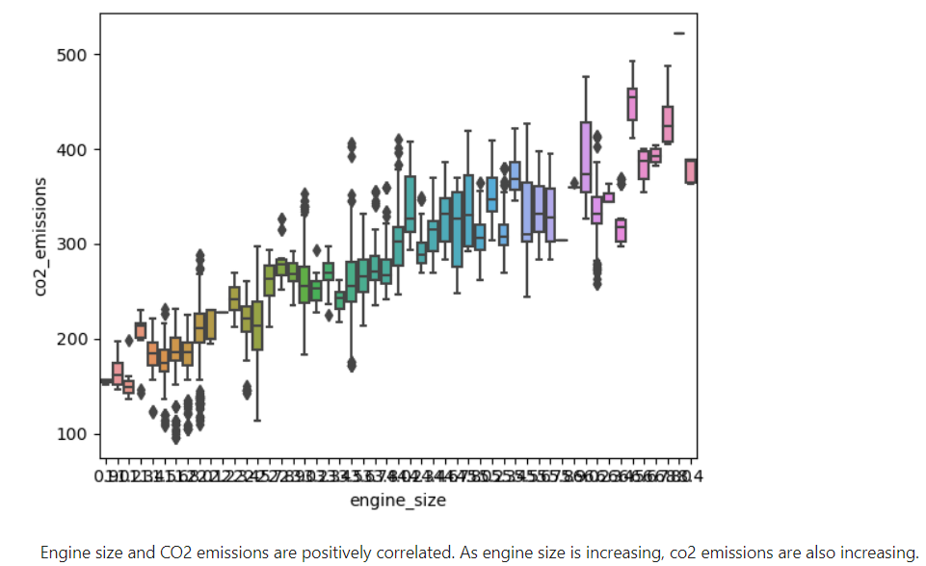

Slide 14
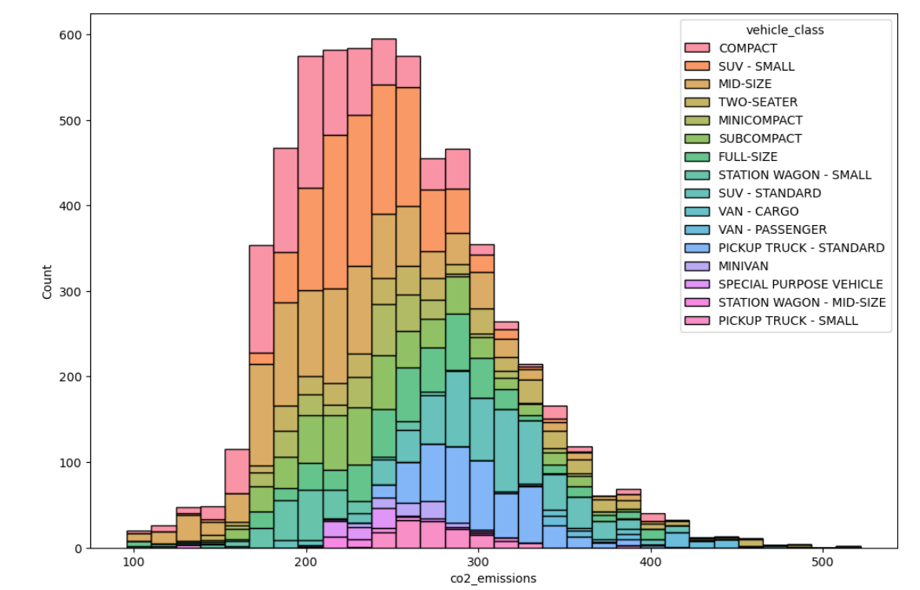

Slide 15
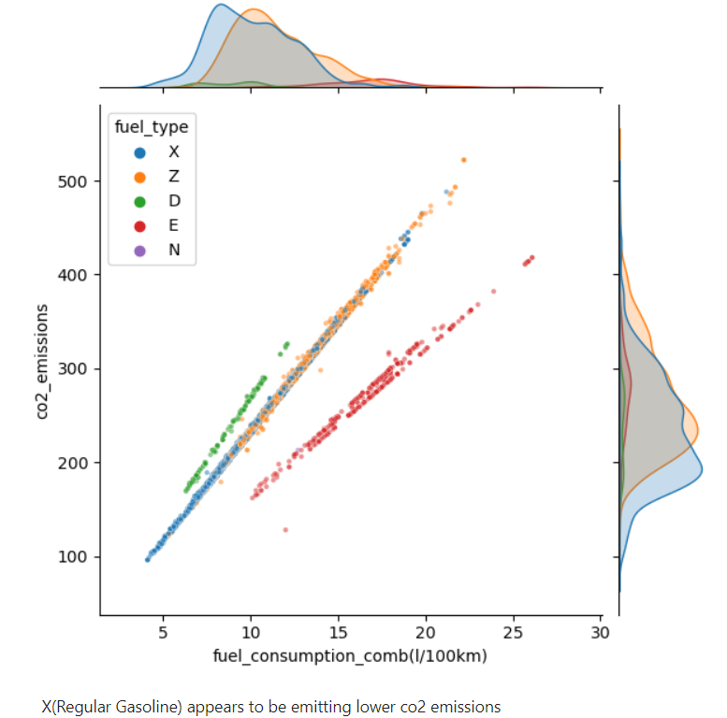

Slide 16
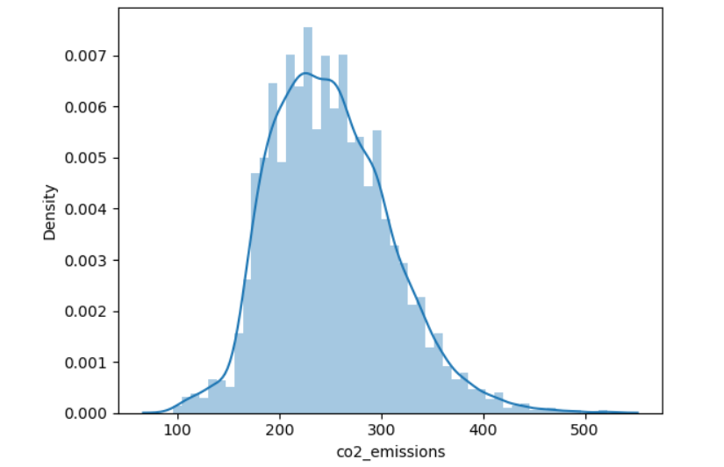

Slide 17
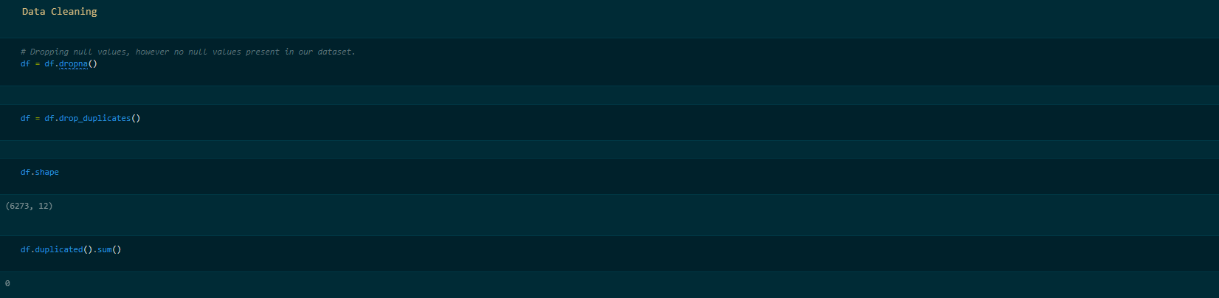
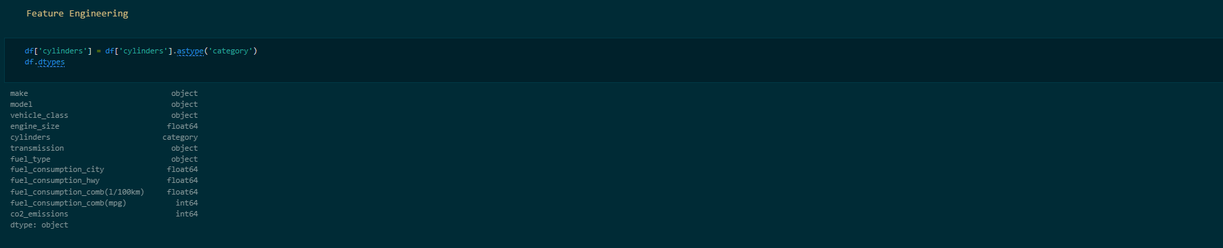
Data Preparation

Slide 18
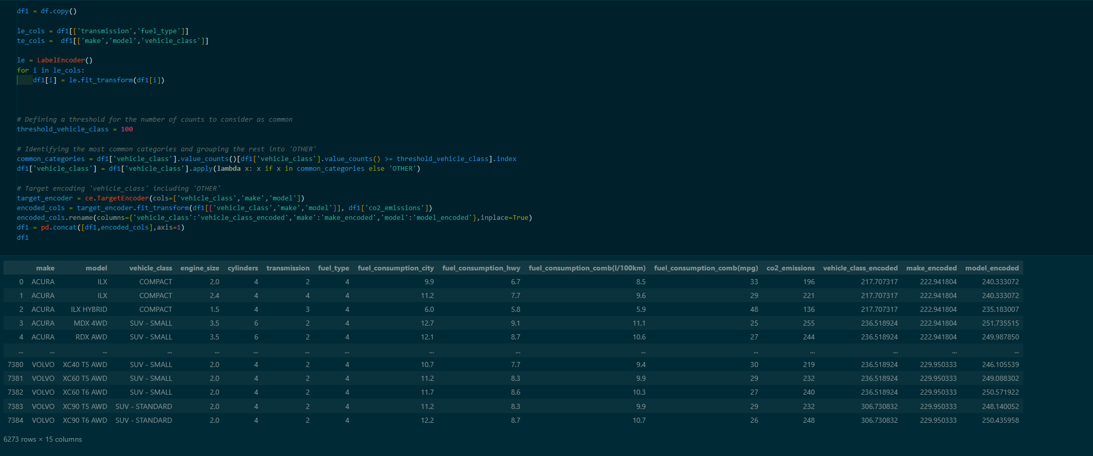

Slide 19
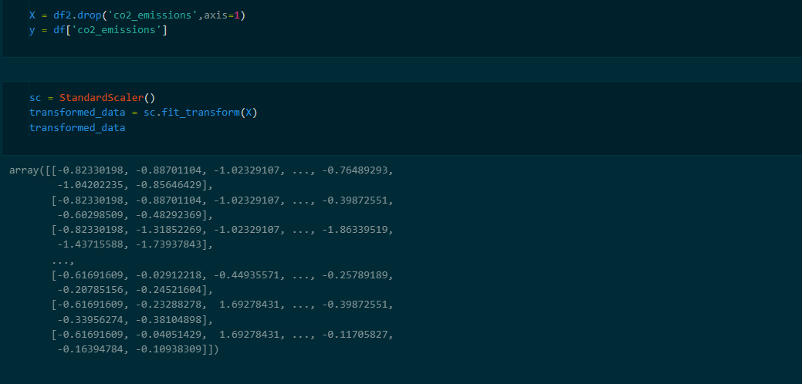
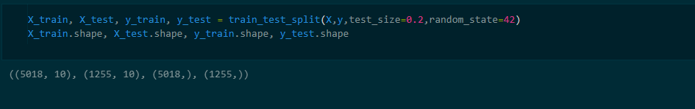

Slide 20

Modelling

Slide 21
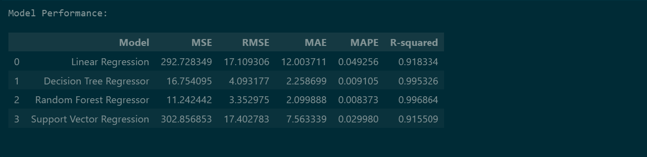
Evaluation

Slide 22
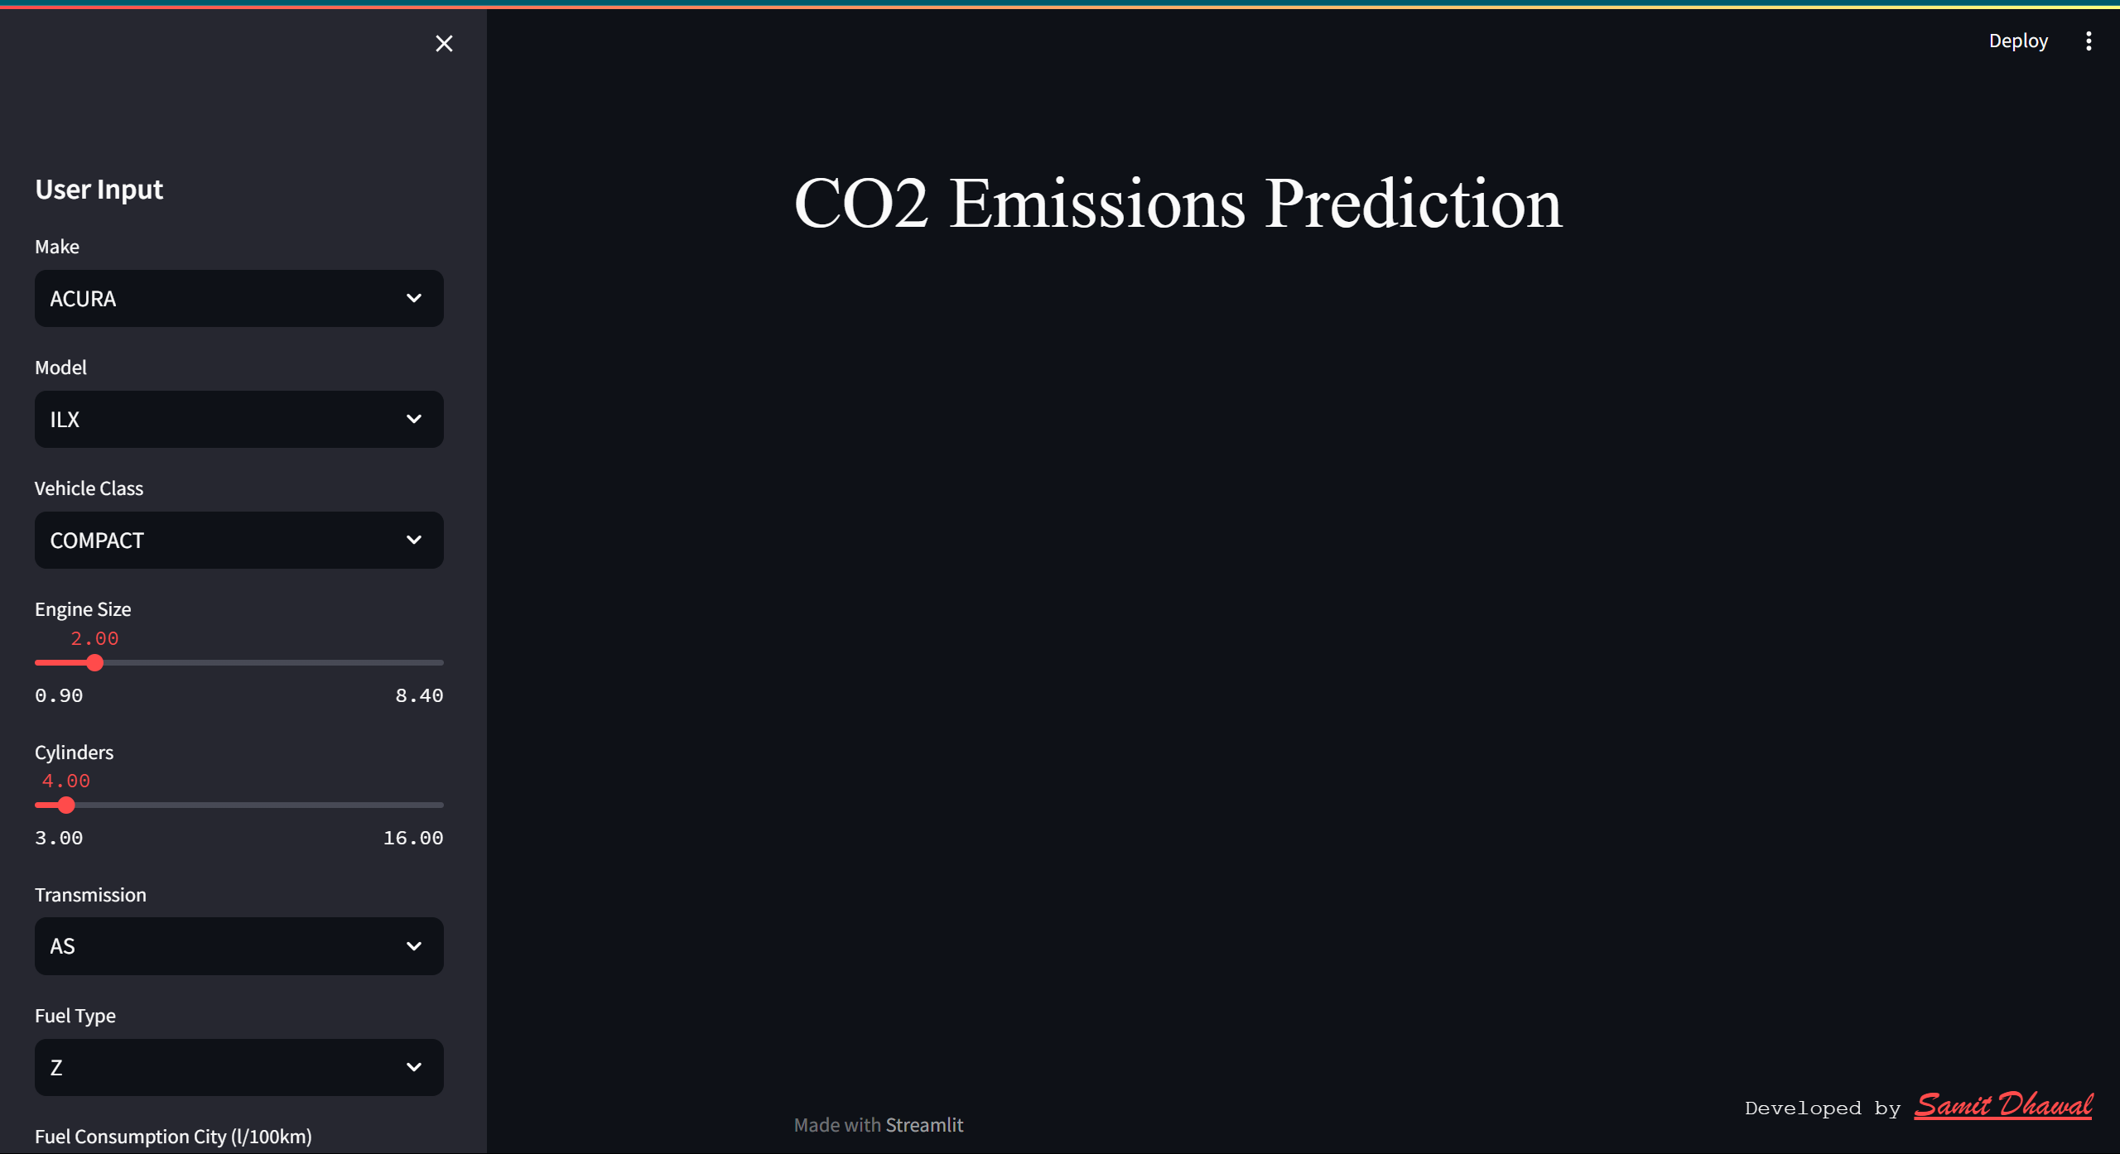
Deployment

Slide 23
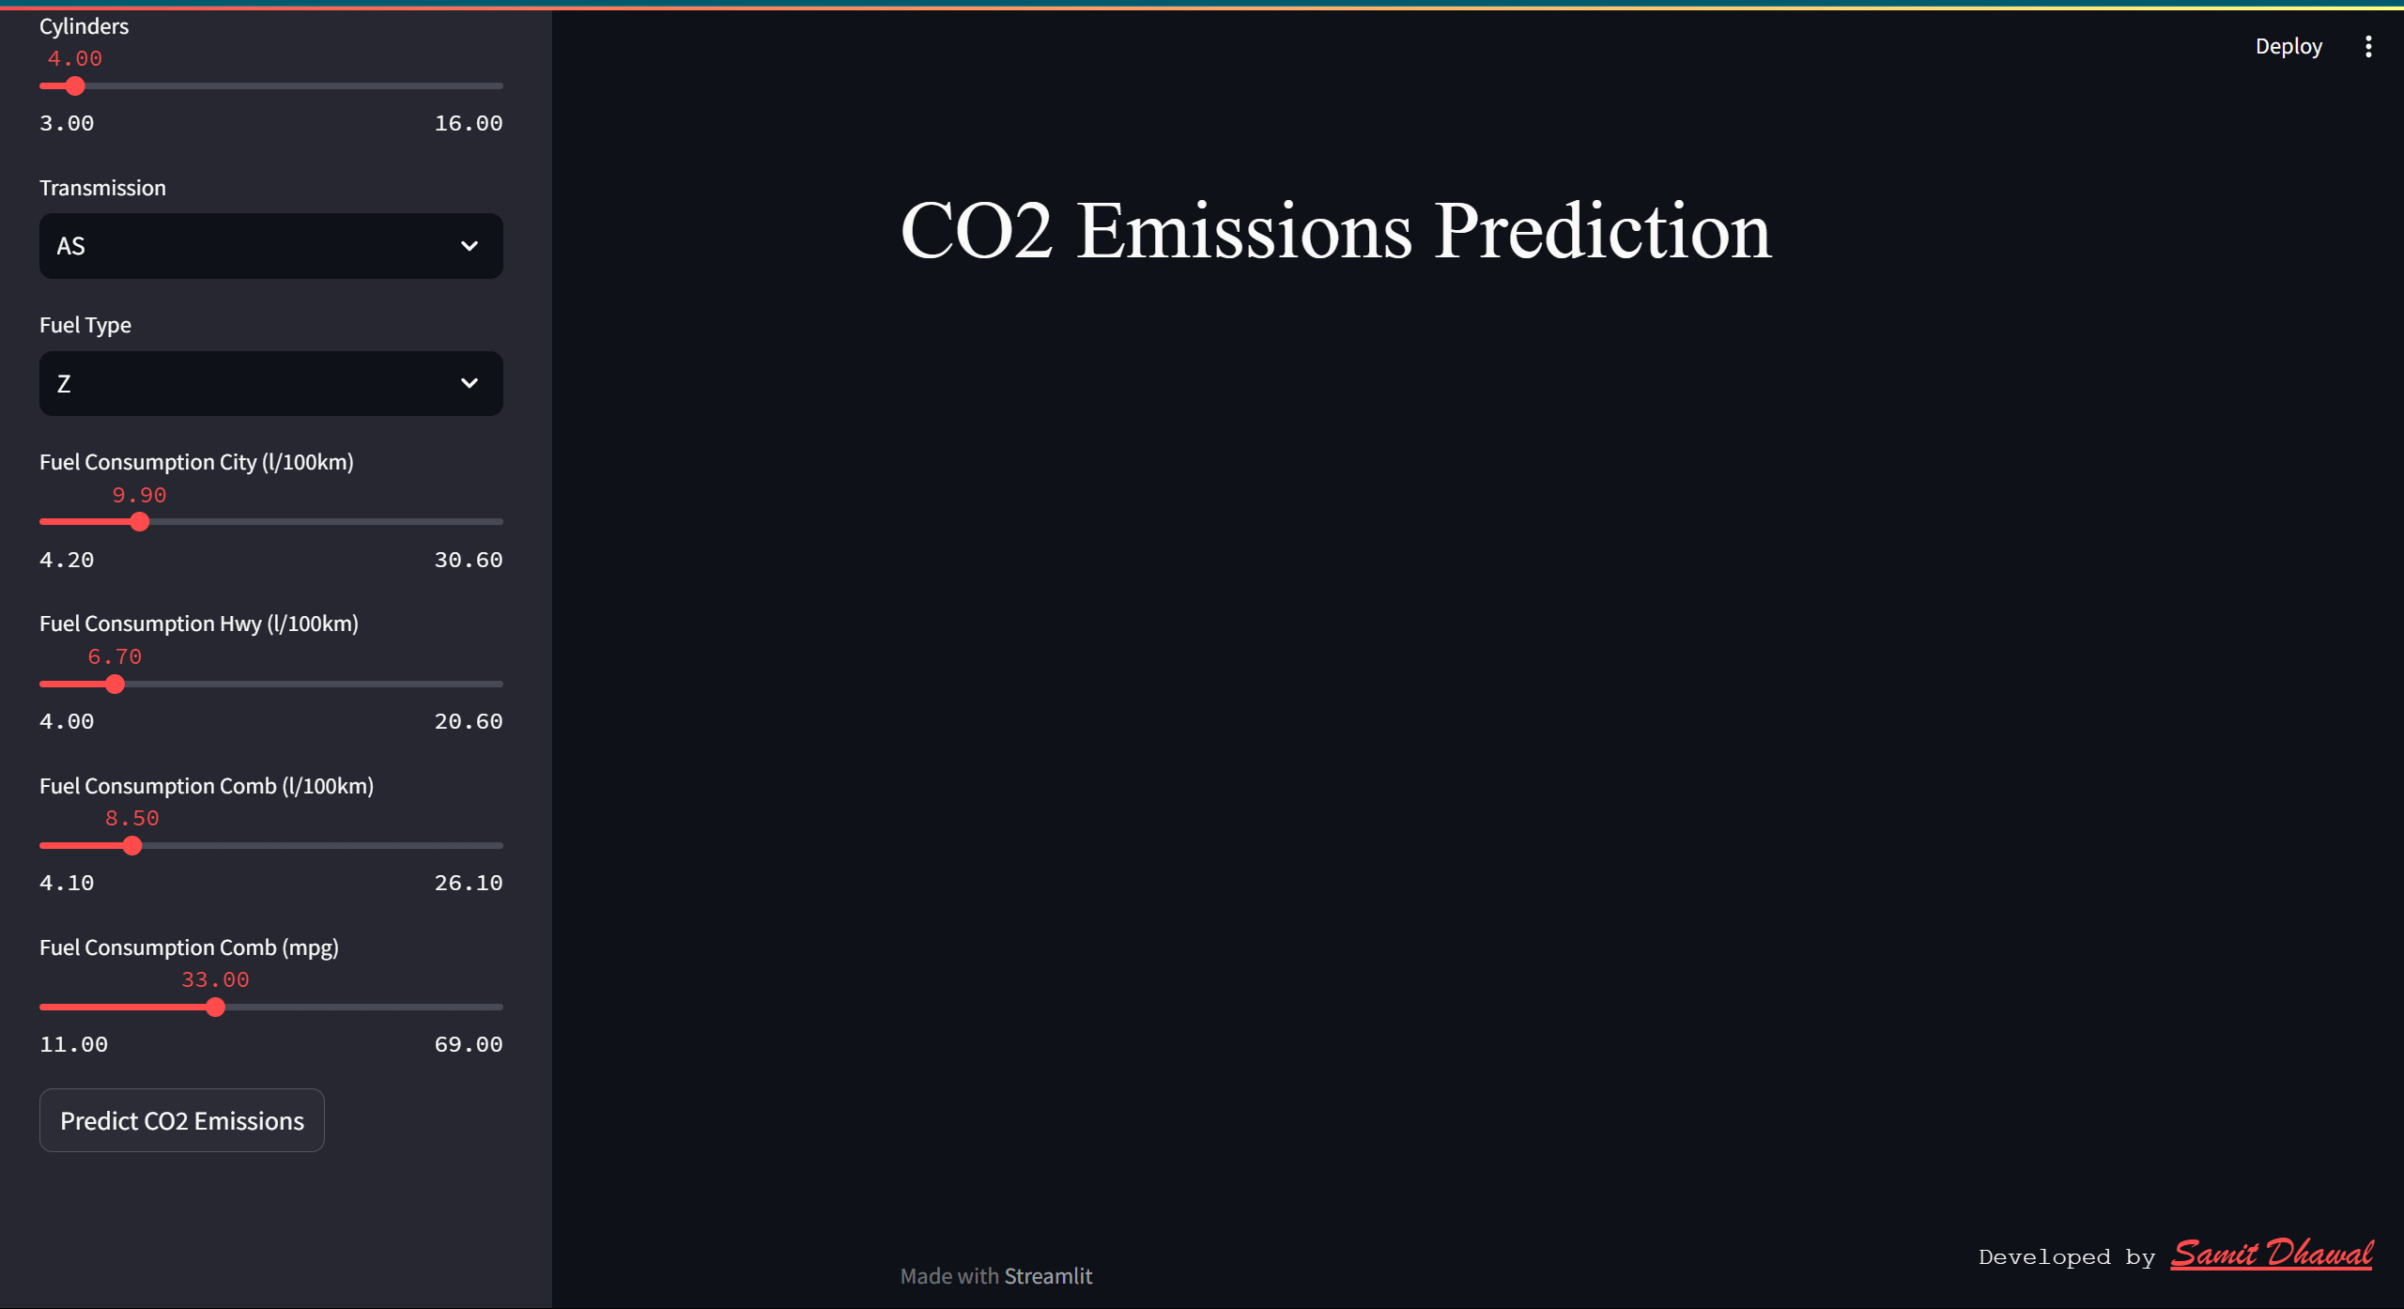

Slide 24
